Slide 1




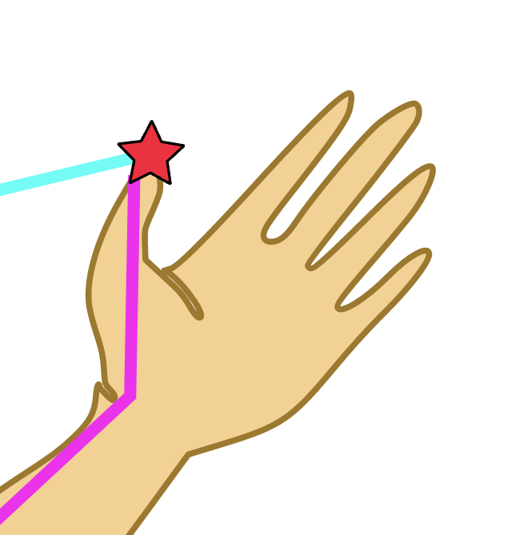




Structure of RIGA code
main.py
lib
load configs
def main()
Creation of model:
Optimizer
Scheduler
Data set
Data loader
Losses
Evaluation metrics
configs
import load_config()
→ Returns dictionary consisting of loaded configuration
data
Subfolder \test, \train and \val:
misc
model
optim
data: tdmatch
train
utils.py
→ def load_config(path): loads config file as dictionary
loss.py
tester.py
trainer.py
utils.py
´indoor\test´
´indoor\train´
→ Large number of files
class MetricLoss(…)
def __init__(…)
def contranstiveLoss(…)
def infoNCE(…)
def circleLoss(…)
def calc_fine_matching_loss(…)
def calc_fine_matching_recall(…)
def calc_recall(…)
def forward(…)
clclass Tester(Trainer)
def __init__(self, config)
def test(self)
def get_trainer(config)
class Trainer(object)
def __init__(self, config)
def _snapshot(self, epoch, name=None)
def _load_pretrain(…)
def _get_lr(…)
def stats_dict(self)
def stats_meter(self)
def inference_one_batch(…)
def inference_one_epoch(…)
def train(self)
def eval(self)
def setup_seed(seed)
def get_correspondences(…)
def matching_descriptors(…)
def square_distance(src, tgt)
def weighted_procrustes(…)
def sinkhorn(…)
def interpolate(weights, points)
def soft_assignment(…)
def get_geometric_structure_embeddings(…)
class AverageMeter(object)
class Timer(object)
class Logger(object)
Very high geodesic distance
Very low euclidean distance
→ Farthest point sampling also to be changed?
Nearest neighbour computation?
dataset
Also here, the code might be changed:
l.240: distance = np.sqrt(…)
Auch hier könnte eine Anpassung notwendig sein:
l.280: np.linalg.norm(…)
l.286: cur_distances = …
´indoor\test´
´indoor\train´
→ Large number of files
model
common.py
dataloader.py
pcd_downsampling.py
tdmatch.py
loss.py
modules.py
ppftransformer.py
utils.py
def get_square_distance_matrix(…) -> only for nearest neighbour computation?
def get_batched_square(…)
def sample_gt_node_correspondence (…)
def calc_gt_patch_correspondence (…)
def farthest_point_subsampling(…)
def collect_local_neighbors(…)
def point2node_sampling(…)
def build_ppf_patch(…) → here, an additional argument for geodesic is introduced
def calc_ppf_cpu(…)
def calc_ppf_gpu(…)
def calc_patch_overlap_ratio(…)
→ and some other functions are implemented here!
def get_dataset(config)
def get_dataloader(dataset, sampler=None, batch_size=1, num_workers=8, shuffle=True, drop_last=True)
class CameraPose
class TDMatchDataset(data.Dataset)
def __init__(…)
def __getitem__(…) → compute geodesic distance, call corresponding function
def __len__(…)
class RIGA(nn.Module)
def __init__(self, config)
def interpolate(…)
def forward(…)
class LearnableLogOptimalTransport(nn.Module)
def __init__(…)
def log_sinkhorn_normalization(…)
def forward(…)
def __repr__(…)
class NodeCorrespondenceSelector(…)
def __init__(…)
def forward(…)
def MLP(channels: list, do_bn=True)
class PointNetfeat(nn.Module)
def __init__(…)
def forward(…)
def attention(…)
class MultiHeadAttention(nn.Module)
def __init__(…)
def forward(…)
class CrossAttention(nn.Module)
def __init__(…)
def forward(…)
class PPFTrans(nn.Module)
def __init__(…)
def forward(…)
def get_activation(…)
class MonteCarloDropout(nn.Module)
def __init__(self, p=0.1)
def forward(self, x)
def get_dropout(…)
modelnet.py
Original_tdmatch.py
Original_tdmatch.py
transforms.py
def download()
def load_data(partition)
def translate_pointcloud(pointcloud)
def jitter_pointcloud(…)
def farthest_subsample_points(…)
class ModelNet40(Dataset)
def __init__(…)
def __getitem__(…)
def __len__(self)
def display_inlier_outlier(…)
class CameraPose
def read_trajectory(…)
def write_trajectory(…)
class PairDataset(data.Dataset)
class OriginalTDMatchDataset(…)
def display_inlier_outlier(…)
class CameraPose
def read_trajectory(…)
def write_trajectory(…)
class PairDataset(data.Dataset)
class OriginalTDMatchDataset(…)
def uniform_2_sphere(…)
class SplitSourceRef
class Resampler
class FixedResampler(Resampler)
class RandomJitter
class RandomCrop
class RandomTransformSE3
class RandomTransformSE3_euler(…)
class RandomRotatorZ(…)
class ShufflePoints
class SetDeterministic
class Dict2DcpList
class Dict2PointnetLKList
registration
benchmark_utils.py
benchmark.py
evaluate_modelnet_c2f.py
evaluate_modelnet.py
def to_array(tensor)
def to_tensor(array)
def to_o3d_feats(embedding)
def mutual_selection(score_mat)
def get_inlier_ratio_correspondence(…)
def get_inlier_ratio(…)
def ransac_pose_estimation(…)
def ransac_pose_estimation_correspondences(…)
def get_scene_split(…)
def write_est_trajectory(…)
def rotation_error(R1, R2)
def translation_error(t1, t2)
def computeTransformationErr(…)
def read_trajectory(…)
def read_trajectory_info(…)
def extract_corresponding_trajectors(…)
def write_trajectory(…)
def read_pairs(…)
def evaluate_registration(…)
def benchmark(…)
def benchmark_evaluation(desc)
def benchmark_evaluation(desc)
visualizer
scripts
snapshot
feature_space.py
plot.py
visualizer.py
evaluate_registration_rotated.py
evaluate_registration.py
def get_color_map(x)
def mesh_sphere(…)
def get_colored_point_cloud_feature(…)
def embed_tsne(data)
def visualize_feature_space(…)
def draw_distance_geo_feat(…)
class Visualizer(object)
def __init__(…)
def get_random_color()
def mesh_sphere(…)
def generate_open3d_vis_pcd_from_points(…)
def show_alignment(self)
def show_correspondences(…)
+ further visualization functions…
evaluate_registration_c2f_rotated.py
evaluate_registration_c2f.py
def benchmark_registration(…)
benchmark_registration_3dlomatch_c2f.sh
benchmark_registration_3dlomatch.sh
benchmark_registration_3dmatch_c2f.sh
benchmark_registration_3dmatch.sh
download_data.sh
→ Execution of Python scripts!
→ Duplication of a lot of files!!
def extract_correspondence(…)
def benchmark_registration(…)
def extract_correspondence(…)
def benchmark_registration(…)
def benchmark_registration(…)

Slide 2



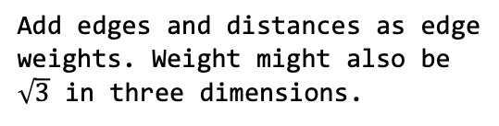




Geodesic distance computation
Convert voxels to undirected graph
$$\sqrt{2}$$
$$1$$
$$1$$
$$1$$
$$\sqrt{2}$$
$$1$$
$$\sqrt{2}$$
Determine direct neighbours of each nodes by computing euclidean distance. (Possible idea: Use max-norm)
Add edges and distances as edge weights. Weight might also be $\sqrt{3}$ in three dimensions.
Result: Weighted graph if iterated for all nodes.
Convert voxels to undirected graph

Slide 3
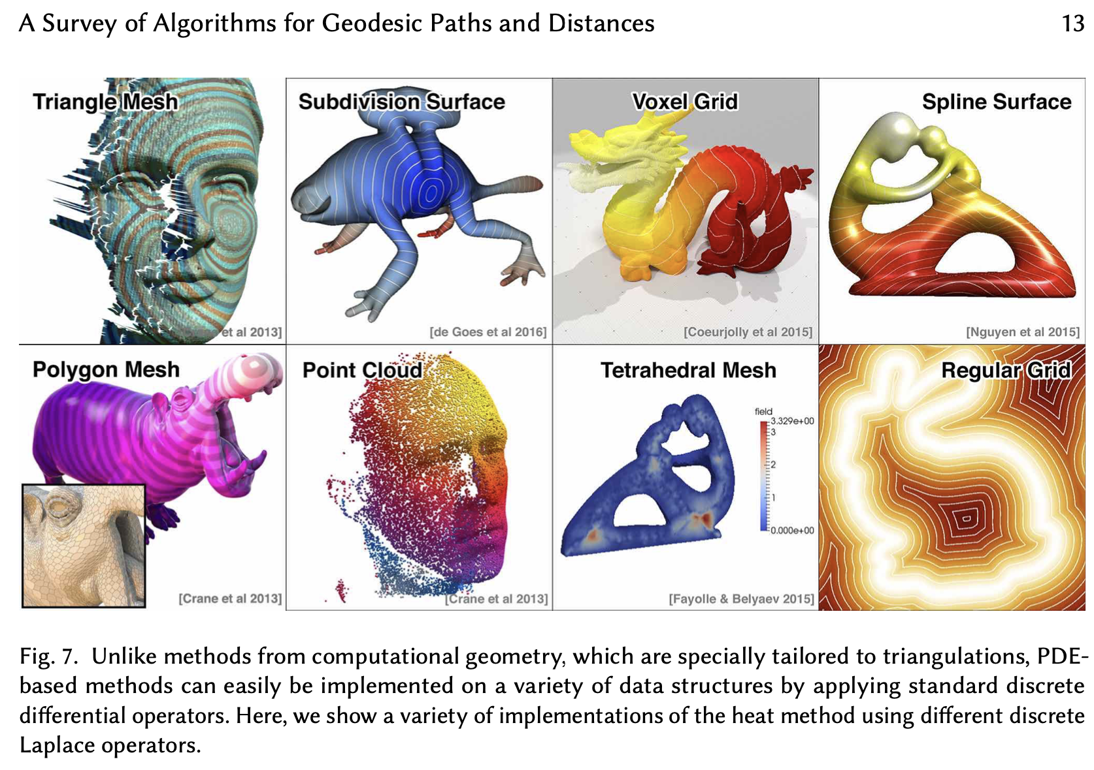
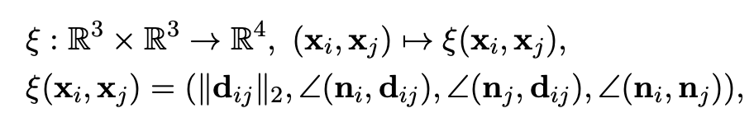
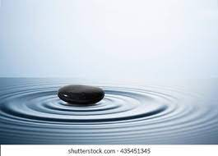
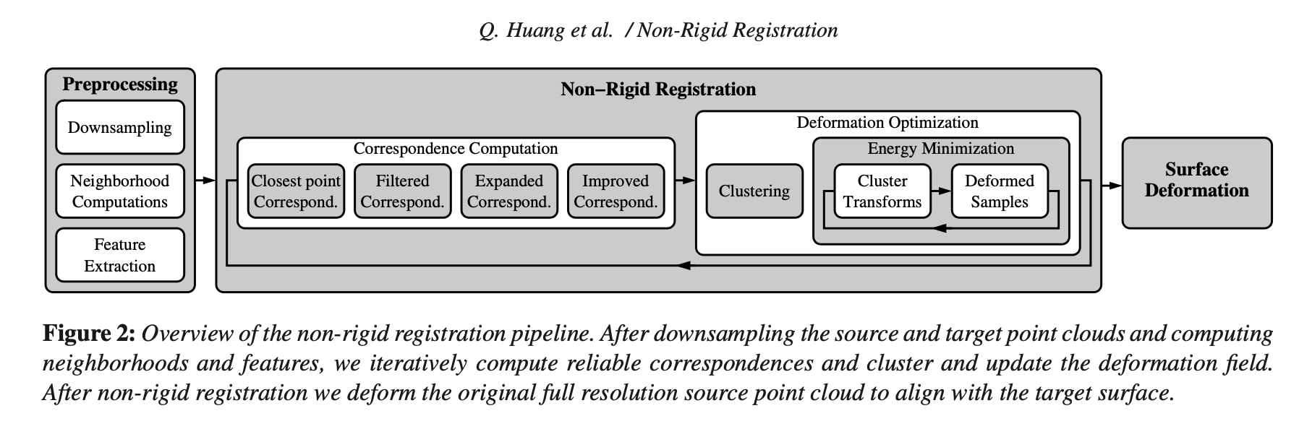
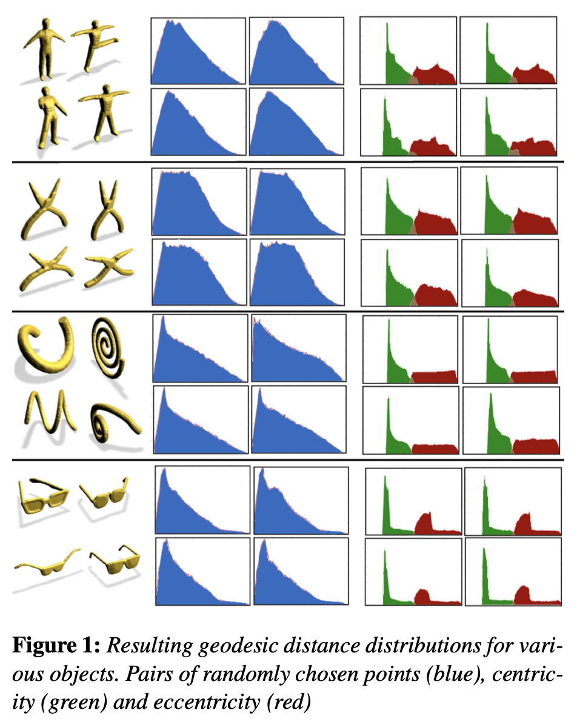

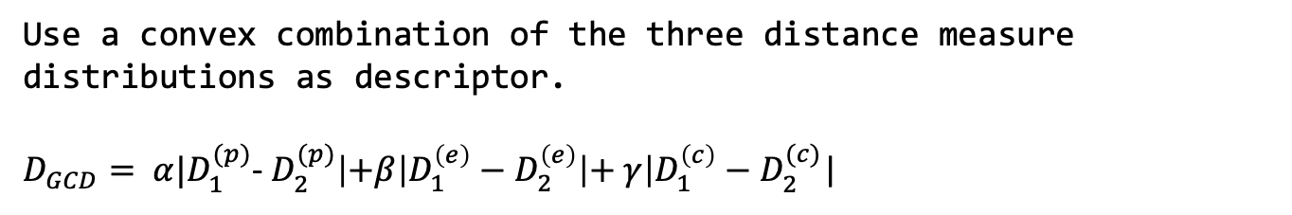
How should the new descriptor look like for nonrigid deformations?
Option 1: Modify the existing descriptor
Things that are preserved under non-rigid deformation:
Geodesic distances
Paths of geodesic distances
Further properties?
Behavior of differential equations on manifolds (→ Laplace-Beltrami operator)
→ Intuitive connection to geodesic distances: Small perturbation at some initial point will send out wavefront. The arrival time of the wavefront is related to geodesic distance.
Use geodesic distance here.
What about the angles?
→ not preserved in non-rigid deformation
This approach leads to the so-called „Fast marching algorithm“
Option 2: Take also the following (geodesic) distance measures into account
Different geodesic distance distribution
Similar eccentricity/centricity
Option 3: Energy minimization methods
Motivation:
Deformation field optimization
Idea:
Deform surface to best align the corresponding points
Split up surface into rigid parts where possible (e.g. lower and upper arm as a “cluster“)
However: Rather used for surfaces than for point clouds
Geodesic distance
Compute geodesic distance distribution for each node to all other nodes
Geodesic eccentricity
Maximum distance to all other voxels (nodes)
Geodesic centricity
Average distance to all other voxels (nodes)
Use a convex combination of the three distance measure distributions as descriptor.
$D_{GCD}= α|D_{1}^{(p)}$- $D_{2}^{(p)}\left|+β\right|D_{1}^{\left(e\right)}−D_{2}^{\left(e\right)}\left|+ γ\right|D_{1}^{\left(c\right)}−D_{2}^{(c)}$|
Source: 3D Shape Matching based on Geodesic Distance Distributions (Martinek, 2012)

